Slide 1

Chapter 2:
The Project Management and Information Technology Context
Information Technology Project Management, Seventh Edition
Note: See the text itself for full citations.

Slide 2
Learning Objectives
Describe the systems view of project management and how it applies to information technology (IT) projects
Understand organizations, including the four frames, organizational structures, and organizational culture
Explain why stakeholder management and top management commitment are critical for a project’s success

Slide 3
Learning Objectives
Understand the concept of a project phase and the project life cycle, and distinguish between project development and product development
Discuss the unique attributes and diverse nature of IT projects
Describe recent trends affecting IT project management, including globalization, outsourcing, virtual teams, and agile project management

Slide 4
Projects Cannot Be Run
In Isolation
Projects must operate in a broad organizational environment
Project managers need to use systems thinking:
  taking a holistic view of carrying out projects within the context of the organization
Senior managers must make sure projects continue to support current business needs

Slide 5
A Systems View of Project Management
A systems approach emerged in the 1950s to describe a more analytical approach to management and problem solving
Three parts include:
  Systems philosophy: an overall model for thinking about things as systems
  Systems analysis: problem-solving approach
  Systems management: address business, technological, and organizational issues before making changes to systems

Slide 6
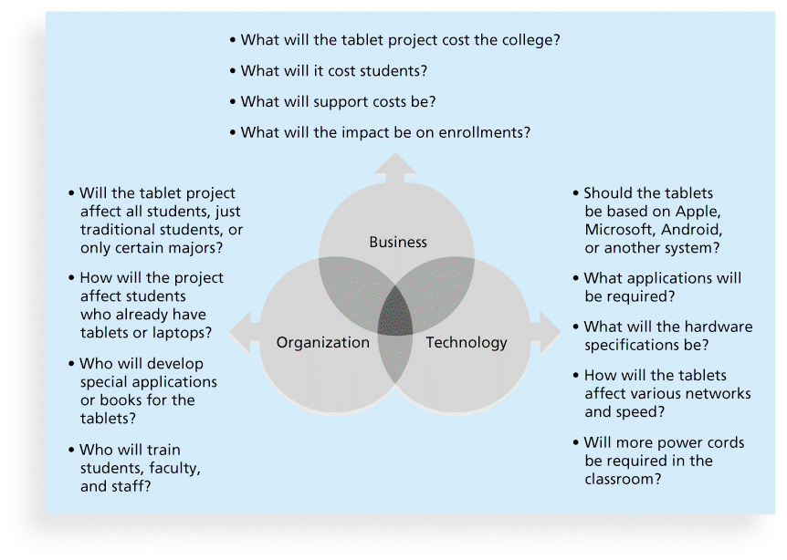
Figure 2-1. Three Sphere Model for Systems Management

Slide 7
Figure 2-1. Three Sphere Model for Systems Management

Slide 8
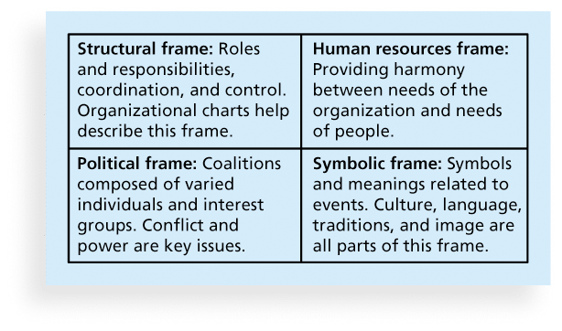
Figure 2-2. Perspectives on Organizations

Slide 9
What Went Wrong?
In a paper titled “A Study in Project Failure,” two researchers examined the success and failure of 214 IT projects over an eight-year period in several European countries.
The researchers found that only one in eight (12.5 percent) were considered successful in terms of meeting scope, time, and cost goals.
The authors said that the culture within many organizations is often to blame
Among other things, people often do not discuss important leadership, stakeholder, and risk management issues

Slide 10
Organizational Structures
3 basic organization structures
  Functional: functional managers report to the CEO
  Project: program managers report to the CEO
  Matrix: middle ground between functional and project structures; personnel often report to two or more bosses; structure can be weak, balanced, or strong matrix

Slide 11
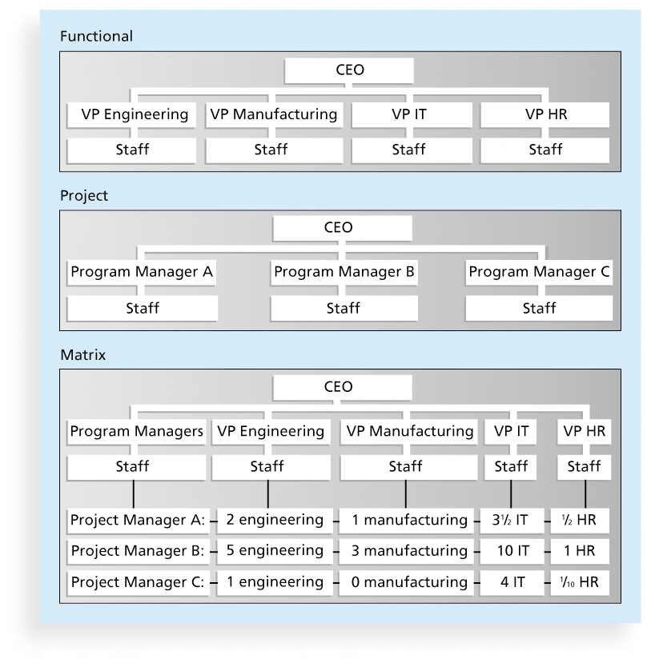
Figure 2-3. Functional, Project, and Matrix Organizational Structures

Slide 12
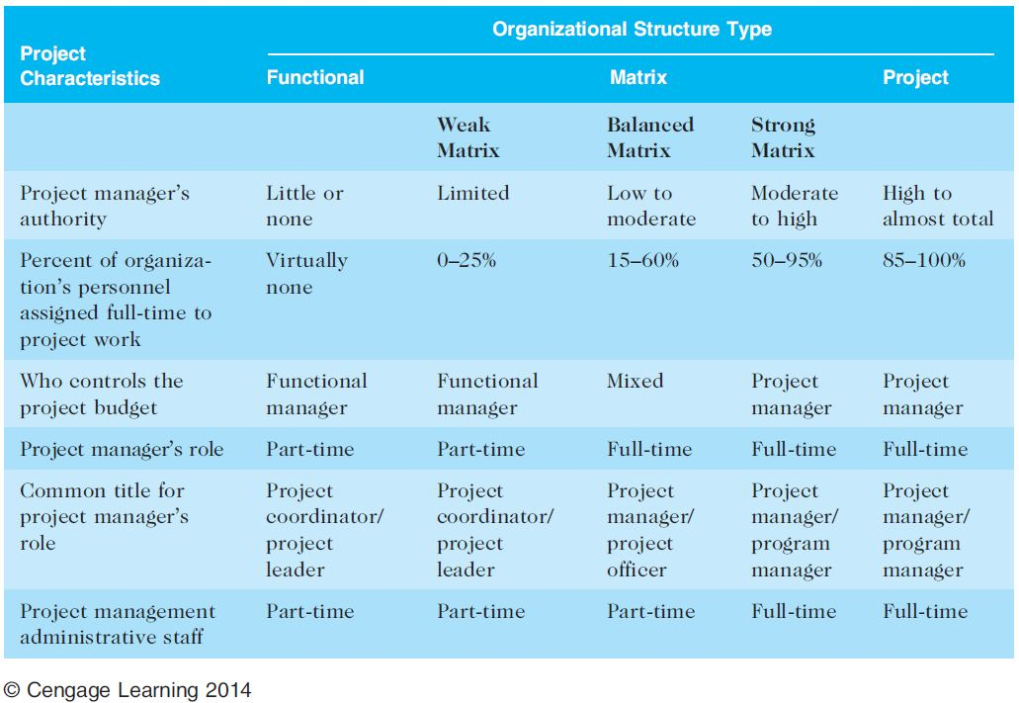
Table 2-1. Organizational Structure Influences on Projects

Slide 13
Organizational Culture
Organizational culture is a set of shared assumptions, values, and behaviors that characterize the functioning of an organization
Many experts believe the underlying causes of many companies’ problems are not the structure or staff, but the culture

Slide 14
Ten Characteristics of Organizational Culture
Member identity*
Group emphasis*
People focus
Unit integration*
Control
Risk tolerance*
Reward criteria*
Conflict tolerance*
Means-ends orientation
Open-systems focus*
*Project work is most successful in an organizational culture where these items are strong/high and other items are balanced.

Slide 15
Stakeholder Management
Project managers must take time to identify, understand, and manage relationships with all project stakeholders
Using the four frames of organizations can help meet stakeholder needs and expectations
Senior executives/top management are very important stakeholders
See Chapter 13, Project Stakeholder Management, for more information

Slide 16
Media Snapshot
The media have often reported on mismanaged IT projects. A classic example and popular case study is the baggage handling system at Denver International Airport (DIA).
The system was supposed to reduce flight delays, shorten waiting times at luggage carousels, and save money, but instead it caused huge problems.
One important reason for this famous project disaster was the failure to recognize the project’s complexity.

Slide 17
The Importance of Top Management Commitment
People in top management positions are key stakeholders in projects
A very important factor in helping project managers successfully lead projects is the level of commitment and support they receive from top management
Without top management commitment, many projects will fail.
Some projects have a senior manager called a champion who acts as a key proponent for a project.

Slide 18
How Top Management Can Help Project Managers
Providing adequate resources
Approving unique project needs in a timely manner
Getting cooperation from other parts of the organization
Mentoring and coaching on leadership issues

Slide 19
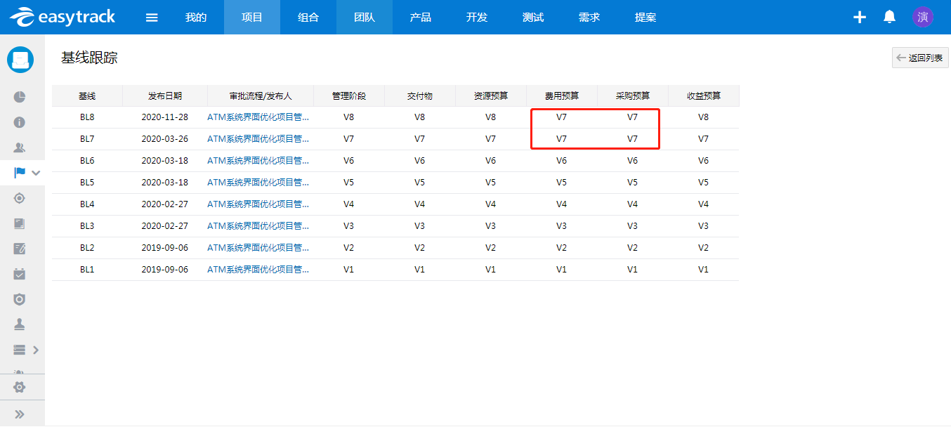

Slide 20
Best Practice
IT governance addresses the authority and control for key IT activities in organizations, including IT infrastructure, IT use, and project management
A lack of IT governance can be dangerous, as evidenced by three well-publicized IT project failures in Australia (Sydney Water’s customer relationship management system, the Royal Melbourne Institute of Technology’s academic management system, and One.Tel’s billing system)

Slide 21
I T治理
(1)麻省理工学院CISR中心(Center of Information System Research)的Wefll和Ross教授认为：“IT冶理是在IT应用过程中，为鼓励期望行为而明确决策权归属和责任担当的框架。”
(2)全球IT治理研究中心(ITG)认为：“IT治理是董事会和执行层的责任，通过领导、组织和过程来保证IT实现和推动企业战略目标。价值、风险与控制是IT治理的核心。”

Slide 22
(3)荷兰Jan Van Bon主编的《IT服务管理：基于IT的全球最佳实践》有这样的提法：IT治理“用于描述企业或政府是否采用有效的机制(就是为鼓励IT应用的期望行为而明确决策权归属和责任承担的框架)，使得IT的应用能够完成组织赋予它的使命，同时平衡信息技术与过J程的风险，确保实现组织的战略目标。
(4)德勤咨询公司提出：IT治理是一个含义，广泛的概念，其主要任务是：保持IT与业务目标一致，推动业务发展，促使收益最大化，台理利用IT资源，IT相关风险的适当管理。

Slide 23
(5)涂伟、张金隆认为，I T治理是公司治理的一部分，是以股东(投资者)为中心的企业利益相关者，为了让IT产生最大收益，并为解决IT决策中的信息不对称问题而设计的与IT有关的决策、激励和约束机制。

Slide 24
Need for Organizational Commitment to Information Technology (IT)
If the organization has a negative attitude toward IT, it will be difficult for an IT project to succeed
Having a Chief Information Officer (CIO) at a high level in the organization helps IT projects
Assigning non-IT people to IT projects also encourage more commitment

Slide 25
Need for Organizational Standards
Standards and guidelines help project managers be more effective
Senior management can encourage
  the use of standard forms and software for project management
  the development and use of guidelines for writing project plans or providing status information
  the creation of a project management office or center of excellence

Slide 26
Project Phases and the Project Life Cycle
A project life cycle is a collection of project phases that defines
  what work will be performed in each phase
  what deliverables will be produced and when
  who is involved in each phase, and
  how management will control and approve work produced in each phase
A deliverable is a product or service produced or provided as part of a project

Slide 27
More on Project Phases
In early phases of a project life cycle
  resource needs are usually lowest
  the level of uncertainty (risk) is highest
  project stakeholders have the greatest opportunity to influence the project
In middle phases of a project life cycle
  the certainty of completing a project improves
  more resources are needed
The final phase of a project life cycle focuses on
  ensuring that project requirements were met
  the sponsor approves completion of the project

Slide 28
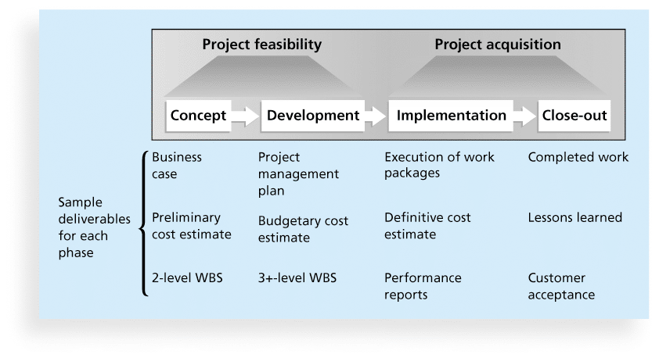
Figure 2-4. Phases of the Traditional Project Life Cycle

Slide 29
Product Life Cycles
Products also have life cycles
The Systems Development Life Cycle (SDLC) is a framework for describing the phases involved in developing and maintaining information systems
Systems development projects can follow
  Predictive life cycle: the scope of the project can be clearly articulated and the schedule and cost can be predicted
  Adaptive Software Development (ASD) life cycle: requirements cannot be clearly expressed, projects are mission driven and component based, using time-based cycles to meet target dates

Slide 30
Predictive Life Cycle Models
Waterfall model: has well-defined, linear stages of systems development and support
Spiral model: shows that software is developed using an iterative or spiral approach rather than a linear approach
Incremental build model: provides for progressive development of operational software
Prototyping model: used for developing prototypes to clarify user requirements
Rapid Application Development (RAD) model: used to produce systems quickly without sacrificing quality

Slide 31
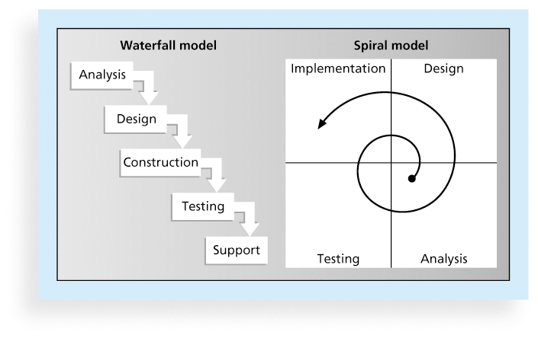
Figure 2-5. Waterfall and Spiral Life Cycle Models

Slide 32
Agile Software Development
Agile software development has become popular to describe new approaches that focus on close collaboration between programming teams and business experts
See the last section of this chapter and Chapter 3 for more information on agile

Slide 33
The Importance of Project Phases and Management Reviews
A project should successfully pass through each of the project phases in order to continue on to the next
Management reviews, also called phase exits or kill points, should occur after each phase to evaluate the project’s progress, likely success, and continued compatibility with organizational goals

Slide 34
What Went Right?
"The real improvement that I saw was in our ability to⎯in the words of Thomas Edison⎯know when to stop beating a dead horse.…Edison's key to success was that he failed fairly often; but as he said, he could recognize a dead horse before it started to smell...In information technology we ride dead horses⎯failing projects⎯a long time before we give up. But what we are seeing now is that we are able to get off them; able to reduce cost overrun and time overrun. That's where the major impact came on the success rate.”*
Many organizations, like Huntington Bancshares, Inc., use an executive steering committee to help keep projects on track.
*Cabanis, Jeannette, "'A Major Impact': The Standish Group's Jim Johnson On Project Management and IT Project Success," PM Network, PMI, Sep.1998, p. 7

Slide 35
The Context of IT Projects
IT projects can be very diverse in terms of size, complexity, products produced, application area, and resource requirements
IT project team members often have diverse backgrounds and skill sets
IT projects use diverse technologies that change rapidly. Even within one technology area, people must be highly specialized

Slide 36
Recent Trends Affecting IT Project Management
Globalization
Outsourcing: Outsourcing is when an organization acquires goods and/or sources from an outside source. Offshoring is sometimes used to describe outsourcing from another country
Virtual teams: A virtual team is a group of individuals who work across time and space using communication technologies
Agile project management

Slide 37
Important Issues and Suggestions Related to Globalization
Issues
  Communications
  Trust
  Common work practices
  Tools
Suggestions
  Employ greater project discipline
  Think global but act local
  Keep project momentum going
  Use newer tools and technology

Slide 38
Outsourcing
Organizations remain competitive by using outsourcing to their advantage, such as finding ways to reduce costs
Their next challenge is to make strategic IT investments with outsourcing by improving their enterprise architecture to ensure that IT infrastructure and business processes are integrated and standardized (See Suggested Readings)
Project managers should become more familiar with negotiating contracts and other outsourcing issues

Slide 39
Global Issues
Outsourcing also has disadvantages. For example, Apple benefits from manufacturing products in China, but it had big problems there after its iPhone 4S launch in January 2012 caused fighting between migrant workers who were hired by scalpers to stand in line to buy the phones.
When Apple said it would not open its store in Beijing, riots resulted and people attacked security guards. The Beijing Apple Store has had problems before. In May 2011, four people were injured when a crowd waiting to buy the iPad 2 turned ugly.

Slide 40
Virtual Teams Advantages
Increasing competiveness and responsiveness by having a team of workers available 24/7
Lowering costs because many virtual workers do not require office space or support beyond their home offices.
Providing more expertise and flexibility by having team members from across the globe working any time of day or night
Increasing the work/life balance for team members by eliminating fixed office hours and the need to travel to work.

Slide 41
Virtual Team Disadvantages
Isolating team members
Increasing the potential for communications problems
Reducing the ability for team members to network and transfer information informally
Increasing the dependence on technology to accomplish work
See text for a list of factors that help virtual teams succeed, including team processes, trust/relationships, leadership style, and team member selection

Slide 42
Agile Project Management
Agile means being able to move quickly and easily, but some people feel that project management, as they have seen it used, does not allow people to work quickly or easily.
Early software development projects often used a waterfall approach, as defined earlier in this chapter. As technology and businesses became more complex, the approach was often difficult to use because requirements were unknown or continuously changing.
Agile today means using a method based on iterative and incremental development, in which requirements and solutions evolve through collaboration.

Slide 43
Agile Makes Sense for Some Projects, But Not All
Many seasoned experts in project management warn people not to fall for the hype associated with Agile.
For example, J. Leroy Ward, Executive Vice President at ESI International, said that “Agile will be seen for what it is … and isn’t….Project management organizations embracing Agile software and product development approaches will continue to grow while being faced with the challenge of demonstrating ROI through Agile adoption.”*
*J. Leroy Ward, “The Top Ten Project Management Trends for 2011,” projecttimes.com
(January 24, 2011).

Slide 44
Manifesto for Agile Software Development
In February 2001, a group of 17 people that called itself the Agile Alliance developed and agreed on the Manifesto for Agile Software Development, as follows:
“We are uncovering better ways of developing software by doing it and helping others do it. Through this work we have come to value:
Individuals and interactions over processes and tools
Working software over comprehensive documentation
Customer collaboration over contract negotiation
Responding to change over following a plan”*
*Agile Manifesto, www.agilemanifesto.org.

Slide 45
Scrum
According to the Scrum Alliance, Scrum is the leading agile development method for completing projects with a complex, innovative scope of work.
The term was coined in 1986 in a Harvard Business Review study that compared high-performing, cross-functional teams to the scrum formation used by rugby teams.

Slide 46
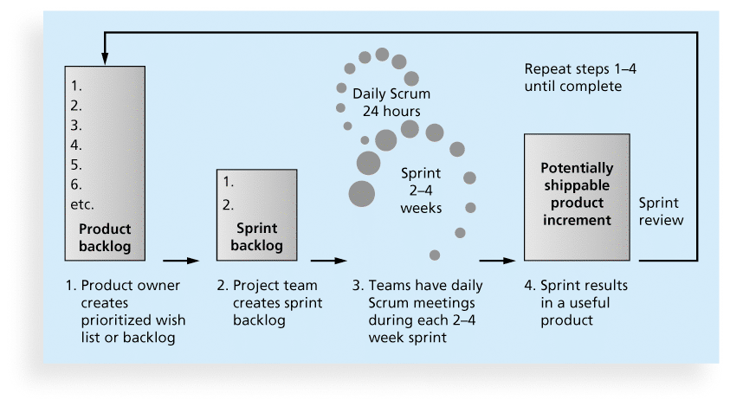
Figure 2-6. Scrum Framework

Slide 47
Agile, the PMBOK® Guide, and a New Certification
The PMBOK® Guide describes best practices for what should be done to manage projects.
Agile is a methodology that describes how to manage projects.
The Project Management Institute (PMI) recognized the increased interest in Agile, and introduced a new certification in 2011 called Agile Certified Practitioner (ACP).
Seasoned project managers understand that they have always had the option of customizing how they run projects, but that project management is not easy, even when using Agile.

Slide 48
Chapter Summary
Project managers need to take a systems approach when working on projects
Organizations have four different frames: structural, human resources, political, and symbolic
The structure and culture of an organization have strong implications for project managers
Projects should successfully pass through each phase of the project life cycle
Project managers need to consider several factors due to the unique context of information technology projects
Recent trends affecting IT project management include globalization, outsourcing, virtual teams, and Agile

Slide 49
快速测验
下面_不是系统管理的三球模型的组成部分。
a.业务
b.信息
c.技术
d.组织

Slide 50
快速测验
在组织4个框架中，__涉及如何举行会议、员工衣着样式和预期工作时间。
a.结构
b.人力资源
c.政治
d标志

Slide 51
快速测验
人员__在组织结构中通常向两个或更多的上级报告。
a.职能型
b.项目型
c.矩阵型
d.混合型

Slide 52
快速测验
项目工作通常在这样的组织文化中最容易成功，该文化具有很高的特性，除了__
a.人员认同
b.强调群体
c.风险容忍
d.控制

Slide 53
快速测验
__是作为项目的一部分所提供的一件产品或一项服务，例如，一份技术报告、一个培训项目或者硬件。
a.可交付成果
b.产品
C.作包
d.切实目标

Slide 54
快速测验
下面__是错误的。
a.分析项目生命周期是项目阶段的集合
b.产品生命周期和项目生命周期是一样的
c.瀑布方法是预测生命周期模型的一个例子
d敏捷开发是自适应生命周期模型的一个例子

Slide 55
快速测验
在开发信息系统时，以下__用来描述一个阶段性的框架
a.系统开发生命周期
b.快速应用软件开发
c预测生命周期
d.极限编程

Slide 56
快速测验
IT 项目的性质不同于许多其他行业的项目，因为它们是很__。
a.昂贵的
b.技术性的
c.多样的
d.具有挑战性的

Slide 57
快速测验
下列术语中，__可以用来描述组织从国外寻找外部资源以获取需要的产品或服务。
a.全球化
b.境外生产
c.出口
d.全球采购

Slide 58
快速测验
__是最主要的敏捷开发方法
a.极限编程
b.冲刺
c.六西格玛
d.Scrum

Slide 59
讨论题
1、传统项目生命周期的四个阶段？
2、组织结构分为哪三类？
3、影响IT项目管理的最新趋势？

Slide 60
讨论题
1、传统项目生命周期的四个阶段？
概念阶段
开发阶段
实施阶段
收尾阶段

Slide 61
讨论题
2、组织结构分为哪三类？
职能型组织结构
项目型组织结构
矩阵型组织结构

Slide 62
讨论题
3、影响IT项目管理的最新趋势？
全球化
外包
虚拟团队
敏捷项目管理

